Slide 1

Predicting Stock Prices
By Adam Parente

Slide 2
The Value in Prediction Models
Naturally to make money
Even a slightly performing model could be used to supplement traditional trading strategy
Traditional strategies (ema crossover, momentum, candlesticks) have a lot of false signals that a machine learning model might help mitigate.
If there is value in these signals, a machine learning model might be able to pick up on the signals and generate a signal for a composite strategy

Slide 3
The Dataset
Data gathered from Polygon API through Alpaca
30 minute intervals from 1/01/2016-1/01/2020
Selected random stocks between the ¼ and ¾ quantiles based on market capitalization value
Full dataset of about 650,000 cases among 47 stocks

Slide 4
Key Features
The percent change in values such as open and close prices are used to make price inputs stationary for min-max scaler
A series of traditional stock metrics that would be used as part of a trading strategy are generated
Candlestick pattern signals
Relative Strength Index (RSI)
Moving Average Convergence Divergence (MACD)
Fibonacci Retracement

Slide 5
Dependent Variable
To help reduce noise, the model predicts whether the stock price goes up in the next 5 time periods.
Predicting a specific price has a high degree of uncertainty
Predicting a narrow time period is increasingly random
Predicting further away is increasingly random
While I use the price movement for the following 5 time periods for the analysis, different dependent variables have similarly poor results.

Slide 6
Models
The primary model is an LSTM model
By using the history of features the model should be better able to learn as it might better capture trends with price changes and indicators.
A Convolutional LSTM is used as a supplement to incorporate convolutional layers into the model which may better highlight key inputs
A series of ensemble classification models are used to compare and validate the performance of the neural network models

Slide 7
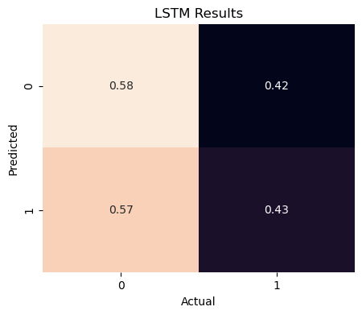
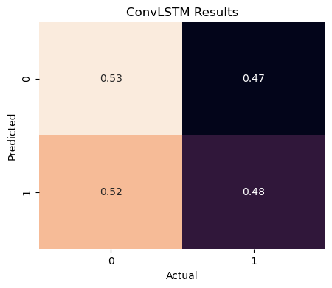
Neural Net Results
LSTM
ConvLSTM
Both models fail to learn

Slide 8
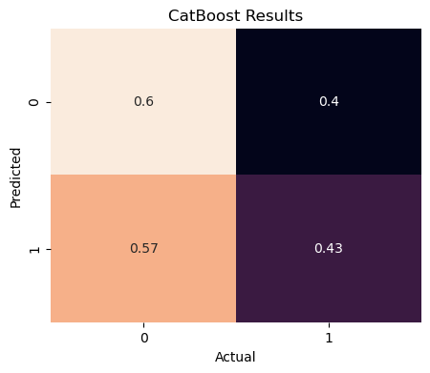
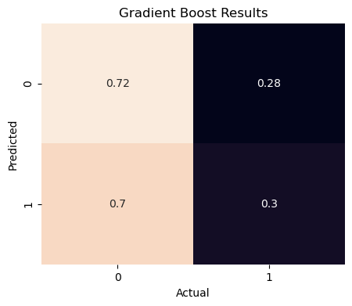
Ensemble Results
CatBoost Classifier
Gradient Boost Classifier
Both models fail to learn

Slide 9
Alternative Approach
Could a model learn to improve predictions for whether a signal is correct or not?
Subset the data to look at positive moving average crossover signals to predict whether profit was made selling at the following negative crossover signal
Only ~10000 train cases and ~6000 test cases
While this should remove a lot of the noise, the same models fail to predict

Slide 10
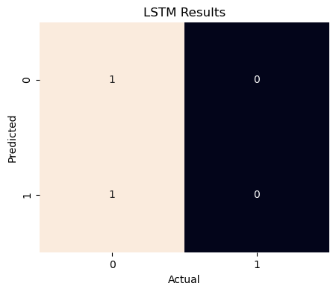
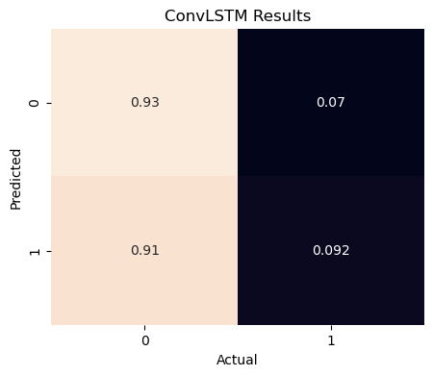
EMA Signal Results
LSTM
ConvLSTM

Slide 11
Why the Models Fail
Despite the use of several trading signals and indicators, there is not enough of a signal to noise ratio among the features
PCA can reduce about 35 variables down to ~10 with minimal loss and capture most of the variance excluding the time component
Stock prices are famously stochastic and in the short term studied here tend to be approximately 0% price difference. Trying to distinguish two categories which are densely populated at the dividing line requires very expressive features

Slide 12
Implications and Future Research
For retail traders a specific rules based strategy is likely more effective than attempts to apply machine learning
More expressive features are necessary
Options data and depth charts would have more information to generate feature with
Extra data is large and expensive
Likely not an issue with time span or the choice of dependent variable based on experimentation

